Slide 1
Berthing Scheduling Application
Group #4
Osborn Collins
Mark A. Pascual
Driane Perez
Daniel Garcia
Justin Chuc
Kevin Godoy

Slide 2
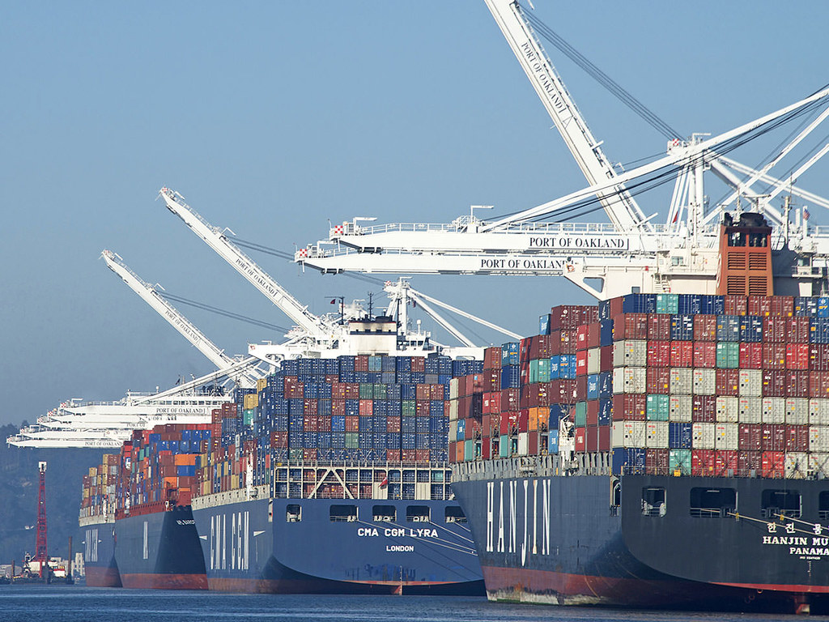

Slide 3
About our application
In the design of this application, we incorporated all the stakeholders at a Berthing facilities. Upon a user logging into our secure application, they will be forwarded to their appropriate dashboard where users can perform a range of tasks, see schedules, ship’s arrival and departure date and post notification of delays among other things.
This application is designed to be easy to use and improve the overall productivity of Berthing facilities.

Slide 4
Management Plan
 | Task to complete | Personnel in charge | Start Date | Finish Date
1 | Revision of Reports #1 and #2 | All Group Members | 10th/04/2022 | 13th/04/2022
2 | Make corrections of Reports #1 and #2 | All Group Members | 14th/04/2022 | 14th/04/2022
3 | Combing Report #1 and #2 (Report #3) | All Group Members | 15th/04/2022 | 15th/04/2022
4 | Finalizing Report #3 | All Group Members | 16th/04/2022 | 30th/04/2022

Slide 5
Management Plan
 | Task to complete | Personnel in charge | Start Date | Finish Date
5 | Revision of Demo #1 | All Group Members | 25th/04/2022 | 30th/04/2022
6 | Finalizing Demo #2 | Daniel Garcia Osborn Collins Mark Pascual Kevin Godoy Driane Peres | 1st/05/2022 | 13th/05/2022
7 | Brochure Preparation PowerPoint Presentation | Mark Pascual Justin Chuc | 9tt/05/2022 | 13th/05/2022
8 | Revision of all documents and Demo #2 Brochure PowerPoint Report #3 Demo #2 | All Group Members | 14th/05/2022 | 15th/05/2022

Slide 6
Demo presentation
Describe the functions
Demonstrate how a user uses the application
Highlight
Interface design
Data processing at the backend
Other important features.

Slide 7
The End!

